Slide 1
Lambdas, Closures,
Generators, and Coroutines
CMSC 330: Programming Languages
Millersville University
Subprograms:
Special
Categories
Notes:
LECTURE OVERVIEW
This lecture studies anonymous functions, the environments they retain, and subprograms that suspend and resume. The language tour introduces lambda syntax. The closure examples then identify captured bindings. The final sections trace control between coroutines and use Python generators to produce or consume values one request at a time.
Source provenance
Slides originally developed by William Killian and modified by Stephanie Schwartz, Gary Zoppetti, and Jingnan Xie. Sources include Robert Sebesta’s Concepts of Programming Languages.

Slide 2
Outline
Lambda Functions
Closures
Resumable Subprograms
Coroutines
Generators
2
Notes:
The lecture follows this order: lambda syntax, captured environments, coroutine control flow, and generators. Keep two questions in view. Which bindings does a function need from its enclosing scope? Which execution state survives while a subprogram is suspended?
Resumable means that a suspended activation can continue from a saved point. Reentrant means that a routine can be entered again before an earlier invocation has completed, with appropriate state management. These are distinct properties. In Python, trying to resume a generator while it is already executing raises ValueError.
References
https://docs.python.org/3/reference/expressions.html#generator-iterator-methods

Slide 3
Lambda Functions
3
Notes:
Introduce an anonymous function as a function value defined directly by an expression. A useful opening example is an addition operation passed to another function. Ask students to identify its parameters and body before comparing the language syntax on the next slides.

Slide 4
Lambda Functions
A lambda expression defines an anonymous function.
function literal
lambda abstraction
anonymous function
lambda expression
Alonzo Church’s lambda calculus dates to the 1930s.
Lambda notation defines functions without naming them.
(λx. x² − 2x + 5) 2
Early Lisp: 1958
4
Notes:
A function can be described directly where a value or an argument is needed. Its parameters have names, but the function itself need not have one. Read the displayed expression as “the function that maps x to x squared minus twice x plus five, applied to two.” To evaluate it, substitute 2 for the free occurrences of x in the body: 2² − 2×2 + 5 = 4 − 4 + 5 = 5. The leading λ introduces the parameter and the dot separates that parameter from the body. The arithmetic is familiar mathematical shorthand rather than a complete presentation of pure lambda calculus.
The terminology varies by language. “Lambda expression” usually refers to the source expression, while “anonymous function” describes the function it creates. Assigning that function to a variable later does not change the fact that it was defined with an anonymous-function expression. Church's work began in the 1930s. McCarthy's own account places adoption of Church's function notation in Lisp's development during 1958.
References
https://www.jstor.org/stable/1968337
https://www-formal.stanford.edu/jmc/history/lisp/node2.html

Slide 5
Lambda Function Tour
Lisp
(lambda () sexpr)
(lambda (x y) (+ x y))
JavaScript
() => expr
() => { stmts… }
(x, y) => x + y
Syntax patterns: expr / sexpr = expression; stmts… = statements.
5
Notes:
The two languages express the same basic idea with different punctuation. In the Lisp example, the parameter list is (x y), and (+ x y) is a prefix expression: apply addition to x and y. In Common Lisp, (funcall (lambda (x y) (+ x y)) 2 3) produces 5. The empty parameter list in the first pattern means the function accepts no arguments.
For JavaScript, everything before => describes the parameters. A concise expression body returns its expression's value, so ((x, y) => x + y)(2, 3) produces 5. A body inside braces is a statement block. If that block should return a value, use an explicit return statement, for example () => { return 2 + 3; }. Merely writing () => { 2 + 3; } returns undefined. Ask students to identify the parameters, the body, and the result in each form. These syntax-tour lines use expr, sexpr and stmts… as explanatory placeholders, so they require replacement before execution.
References
https://www.lispworks.com/documentation/HyperSpec/Body/03_ac.htm
https://tc39.es/ecma262/multipage/ecmascript-language-functions-and-classes.html#sec-arrow-function-definitions

Slide 6
Lambda Function Tour
OCaml
fun () -> ...
fun x y -> x + y
Java
() -> expr
() -> { stmts… }
(x, y) -> x + y
(x, y) -> { return x + y; }
(double x, double y) -> { return x + y; }
Java lambdas use a target functional-interface type.
6
Notes:
In OCaml, fun x y -> x + y is shorthand for fun x -> fun y -> x + y. It is a curried function: applying it to 2 produces a function waiting for the second integer. For example, let add = fun x y -> x + y in add 2 3 evaluates to 5. The pattern () is the unit value, so fun () -> ... is conventionally used when the caller supplies unit to trigger an action or delayed computation. The dots on this slide are placeholders.
Java lambdas need a target functional-interface type. For a concrete example, java.util.function.DoubleBinaryOperator add = (double x, double y) -> { return x + y; }; then add.applyAsDouble(2.0, 3.0) returns 5.0. The two untyped addition variants can use the same target type, which supplies their parameter types. An expression body provides a result directly. A value-returning block body uses return. A void-compatible block can instead perform statements. A bare lambda is therefore a syntax example, not a complete Java declaration.
References
https://ocaml.org/manual/5.3/expr.html#sss:expr-functions
https://docs.oracle.com/javase/specs/jls/se25/html/jls-15.html#jls-15.27

Slide 7
Lambda Function Tour
Python
lambda: expr
lambda x, y: x + y
Swift
{ () in expr }
{ () in stmts… }
{ x, y in x + y }
{ (x: Int, y: Int) -> Int in
return x + y
}
{ $0 + $1 }
7
Notes:
Python's lambda body is one expression. Its value becomes the function's return value. For example, add = lambda x, y: x + y followed by add(2, 3) produces 5. A lambda cannot contain an ordinary statement block; use def when the body needs several statements. The first Python pattern accepts no parameters and evaluates the expression when called.
Swift calls these anonymous function values closure expressions. Its integer type is spelled Int, with an uppercase I. The fully annotated version makes both parameter types and the result type explicit. When a surrounding declaration supplies the function type, the shorter forms can rely on inference: let add: (Int, Int) -> Int = { $0 + $1 }. Calling add(2, 3) returns 5. Here $0 and $1 refer to the first and second arguments. In a single-expression closure, the expression's value can be returned implicitly. The in keyword separates an explicit parameter list from the body. The syntax placeholders describe patterns rather than complete executable programs.
References
https://docs.python.org/3/reference/expressions.html#lambda
https://docs.swift.org/latest/documentation/the-swift-programming-language/closures/

Slide 8
Lambda Function Tour
C++
[]() { stmts… }
[](auto x, auto y) { return x + y; }
[](int x, int y) -> int {
return x + y;
}
Ruby
lambda { expr }
lambda { stmts… }
lambda { |x, y| x + y }
->(x, y) { x + y }
8
Notes:
In C++, the leading brackets are the capture clause. Empty brackets mean this lambda captures no enclosing local variables. The parentheses hold ordinary function parameters. The auto parameters create a generic lambda, so the argument types are determined for a call. For example, auto add = [](auto x, auto y) { return x + y; }; then add(2, 3) gives 5. The last version explicitly fixes the parameters and result to int. Returning a value from a C++ lambda uses return in the block.
Ruby offers both the lambda method with a block and the -> literal form. The bars in |x, y| delimit the block parameters. Ruby uses the last evaluated expression as the result, so add = ->(x, y) { x + y }; add.call(2, 3) returns 5. A Ruby lambda is a Proc with lambda semantics, including stricter argument-count checking than an ordinary non-lambda proc. The expressions and statements shown as placeholders must be replaced before running the snippets.
References
https://eel.is/c++draft/expr.prim.lambda
https://docs.ruby-lang.org/en/master/Proc.html

Slide 9
Closures
9
Notes:
This section adds the surrounding environment to the anonymous-function syntax just introduced. Ask students which values a function needs that are not supplied as its own parameters. The following examples identify those enclosing bindings and show how capture rules differ between languages.

Slide 10
Closures
A closure combines function code with the environment
needed for its non-local bindings.
A lambda expression can create a closure.
Named nested functions can also form closures.
Implicit capture: Lisp, Java, JavaScript, OCaml,
Python, Swift, and Ruby.
Swift (inside a function)
var base = 10
let f = { (x: Int) -> Int in
return x + base
}
C++ uses a capture clause: [n], [=], or [&].
10
Notes:
A lambda describes how a function is written. A closure describes a function value together with the environment needed to resolve its enclosing bindings. These ideas overlap. A lambda can produce a closure, and a named nested function can also form a closure. The captured environment may preserve a binding or a value, depending on the language and capture rule.
Read the Swift snippet as code inside an enclosing function, so base is a local variable of that function. The closure parameter is x. The body also needs base, which comes from the surrounding scope. With base equal to 10, f(5) produces 15. If that enclosing scope then assigns base = 20, a subsequent f(5) produces 25. The closure continues to refer to that local binding. Placing the same snippet at file scope would instead demonstrate access to a global variable.
Capture restrictions differ. Java permits captured local variables only when they are final or effectively final. C++ exposes capture choices in square brackets. Swift can also use an explicit capture list when a different capture behavior is required.
C++ uses a capture clause such as [n], [=], or [&], as shown in the following examples.
References
https://www.lispworks.com/documentation/HyperSpec/Body/03_ad.htm
https://docs.swift.org/latest/documentation/the-swift-programming-language/closures/
https://docs.oracle.com/javase/specs/jls/se25/html/jls-15.html#jls-15.27
https://eel.is/c++draft/expr.prim.lambda.capture

Slide 11
Closure Example
JavaScript
x => y => x + y
x => { return y => x + y; }
The returned function keeps access to x.
OCaml
let multiply n lst =
List.map (fun x -> n * x) lst
The mapping function keeps access to n.
11
Notes:
Start with JavaScript: const makeAdder = x => y => x + y; const add3 = makeAdder(3);. Calling makeAdder binds x to 3 and returns the inner function. add3(4) then supplies y = 4, so the body computes 3 + 4 = 7. The outer call has finished, yet the inner function still has access to its x binding. A second call, const add10 = makeAdder(10);, creates a separate binding: add10(4) gives 14, while add3(4) still gives 7. The block-bodied version writes the outer return explicitly and has the same behavior.
For OCaml, evaluate multiply 3 [1; 2; 3]. The mapping lambda takes one list element as x and closes over the current n = 3. List.map applies it to 1, 2, and 3, building [3; 6; 9]. The original list remains unchanged. In this example x is a lambda parameter and n is a captured enclosing binding. This distinction prepares students for the explicit C++ capture list on the next slide.
References
https://tc39.es/ecma262/multipage/ecmascript-language-functions-and-classes.html#sec-arrow-function-definitions
https://ocaml.org/manual/5.3/api/List.html

Slide 12
Closure Example
C++20
namespace r = std::ranges;
std::vector<int>
multiply(int n, std::vector<int> list) {
r::for_each(list, [n] (int& value) {
value *= n;
});
return list;
}
[n] explicitly captures n by value.
value *= n updates each element of the local vector.
12
Notes:
Compile this example as C++20 or later with #include <algorithm> and #include <vector>. The alias r abbreviates std::ranges. For multiply(3, {1, 2, 3}), list is the function's local vector. The lambda's [n] capture stores a copy of the current value 3. On each iteration, int& value refers to an element of that vector. The assignment multiplies the first element to 3, the second to 6, and the third to 9. The function then returns {3, 6, 9}.
The assignment is essential. Returning value * n from the callback only computes a temporary result. for_each ignores that result, so it would leave the vector unchanged. Ask students to predict the difference between those two bodies before running them.
The capture and the parameter are independent: n is captured by value, while value is a reference parameter supplied by for_each. Because the outer vector parameter is passed by value, passing an existing lvalue vector copies it and leaves the caller's vector unchanged. The returned vector contains the multiplied elements. Arithmetic is assumed to remain within int's representable range.
References
https://eel.is/c++draft/alg.foreach
https://eel.is/c++draft/expr.prim.lambda.capture

Slide 13
Closure Example
C++20
namespace r = std::ranges;
std::vector<int>
multiply(int n, std::vector<int> list) {
r::for_each(list, [=] (int& value) {
value *= n;
});
return list;
}
[=] defaults to copying captured enclosing locals.
Here the body uses and captures n.
13
Notes:
This version changes only the capture clause. [=] requests copy capture by default for eligible enclosing local entities that the lambda needs. In this body, the relevant captured variable is n. Unrelated local variables are not automatically copied, and globals do not require capture. The vector list is the range argument outside the lambda body, so this lambda does not need to capture it.
Trace multiply(3, {1, 2, 3}) exactly as before. The closure supplies its copy of n, and each call receives an int& referring to the next local vector element. value *= n produces {3, 6, 9}. The reference parameter still allows element mutation even though the enclosing n is copied.
To distinguish copy capture from reference capture, construct a lambda while n is 3, then assign n = 10 before invoking it. A [=] lambda evaluating n * 2 still produces 6 because it uses the captured copy. In the multiply function shown, n does not change between construction and use, so this version gives the same result as explicit [n].
References
https://eel.is/c++draft/expr.prim.lambda.capture
https://eel.is/c++draft/alg.foreach

Slide 14
Closure Example
C++20
namespace r = std::ranges;
std::vector<int>
multiply(int n, std::vector<int> list) {
r::for_each(list, [&] (int& value) {
value *= n;
});
return list;
}
[&] defaults to capturing enclosing locals
by reference.
n stays alive throughout this for_each call.
14
Notes:
The [&] capture default makes this lambda refer to the enclosing n rather than storing an independent copy of its value. The body still receives value as an int& parameter, so it updates each element of list. Calling multiply(3, {1, 2, 3}) therefore again returns {3, 6, 9}. The outer n stays alive for the entire synchronous for_each call, making this use of the reference valid.
For comparison, create a lambda while n is 3 and then set n = 10 before invoking it. A lambda using [&] and computing n * 2 now produces 20, whereas a copy-capturing version produces 6. This example separates the choice of capture from the multiplication algorithm.
Ask what would happen if multiply returned a lambda capturing its local n by reference instead of using it before returning. The local n would be destroyed when multiply finished. Invoking that returned closure later would access an expired object. An explicit [n] copy is appropriate when a returned function should retain the integer value independently. Capture only what is needed when that makes dependencies and lifetimes clearer.
References
https://eel.is/c++draft/expr.prim.lambda.capture
https://eel.is/c++draft/alg.foreach

Slide 15
Coroutines
15
Notes:
This section changes the control-flow model. An ordinary call starts a fresh invocation, which then returns or raises an exception. A coroutine activation can instead preserve its current execution state while it is suspended and continue later. The next slides first recall ordinary subprogram control, then show explicit transfers between coroutines, and finally use Python's generator interface to demonstrate the same pause-and-resume idea. The Python example is a generator used as a coroutine that consumes strings sent by its caller. It is separate from the native async def coroutine API used by asyncio.
References
https://peps.python.org/pep-0342/
https://peps.python.org/pep-0380/

Slide 16
Subprogram Definition
A conventional subprogram has…
One initial entry point
One or more possible exit points
16
Notes:
Use this as a prediction question before the expanded slide. Ask where a fresh call begins and how it can finish. For the ordinary structured functions used in this course, a call enters at the beginning of the function body. An invocation may leave through an explicit return, through reaching the end where the language permits it, or through an uncaught exception. The existence of possible exit paths does not guarantee termination: an invocation can still remain in an infinite loop. This is a description of ordinary call-and-return behavior, rather than a universal rule that excludes every historical language feature. Most importantly, a later ordinary call begins a new invocation; it does not automatically continue a previously returned invocation. That distinction prepares the suspension-and-resumption examples that follow.

Slide 17
Subprogram Definition
A conventional subprogram has…
One initial entry point
The beginning of the function
One or more possible exit points
Return statements throughout the function
Exceptional control flow, covered later
17
Notes:
Point to the highlighted beginning-of-function line and ask what happens when the caller invokes the function again after a return. A new activation begins at the same initial entry point, with newly supplied arguments and a new local execution context. Multiple return statements are alternative ways for that activation to finish; they do not create extra starting locations for a later call. An uncaught exception also transfers control out and is handled according to the language's exception rules. A coroutine introduces a different event: suspension. The activation remains available, with its local state, and a later resume continues at the saved suspension point. Avoid calling this reentrancy. Reentrancy concerns whether another invocation may enter a routine while an earlier one is still active. Resuming a suspended activation and starting another activation are distinct operations.
References
https://docs.python.org/3.13/reference/expressions.html#generator-iterator-methods

Slide 18
Coroutines
A coroutine can suspend, retain its state, and resume later.
Initial execution starts at the beginning.
Later resumes continue from the saved suspension point.
Symmetric control transfers directly between coroutines.
Asymmetric control yields back to a resumer.
On one thread, cooperative execution is interleaved.
Tasks take turns making progress, one running at a time.
18
Notes:
A suspension point records where execution will continue and preserves the activation's required local state. The first execution of the body begins at its start; after a yield or another suspension operation, a resume continues from that saved point. Creation and initial execution need not be the same event: the Python generator object in the upcoming example is created before its body runs. The diagrams on the next two slides show symmetric control. A can transfer directly to B, and B can transfer directly to A. In an asymmetric interface, a caller resumes a coroutine and a yield transfers control back to that caller. These are different organizations of the same broad suspension-and-resumption idea. For the illustrated single-threaded cooperative case, only one participant runs at a time, while each participant makes progress over time. This is concurrency through interleaving. Parallel execution is a separate scheduling possibility; Go, for example, can run goroutines on multiple operating-system threads. Also distinguish resumption from reentrancy: Python rejects a request to re-enter a generator that is already executing.
References
https://docs.python.org/3.13/reference/expressions.html#generator-iterator-methods
https://www.lua.org/pil/9.1.html
https://docs.julialang.org/en/v1/manual/asynchronous-programming/
https://go.dev/doc/faq#goroutines

Slide 19
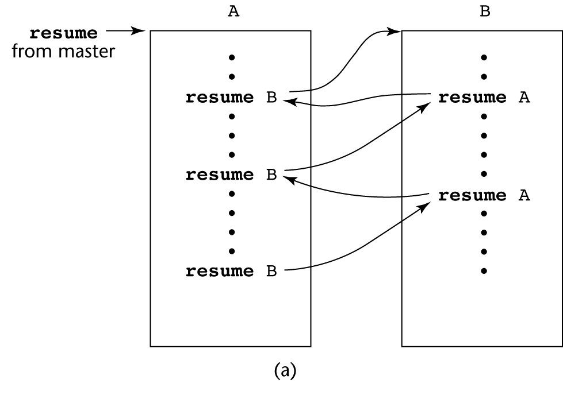
Coroutines Illustrated:
Possible Execution Controls
19
Notes:
Trace the arrows in time order. The master first resumes A at its beginning. A performs the work represented by the first dots and reaches its first resume B. Because B has not run before, B starts at the top. B later reaches resume A, which makes A continue immediately after the transfer that suspended it. A does not restart at its first dot. When A reaches its second resume B, B similarly continues after its previous resume A. The same two activations retain their progress throughout these transfers. Ask students to point to the next dot executed after each arrow before revealing the answer. This picture illustrates symmetric coroutines because either participant can name the other as its next destination. In this model the arrows transfer control; they do not create new activations or launch simultaneous execution. The master initiates the sequence, but A and B subsequently exchange control directly.
References
https://docs.julialang.org/en/v1/manual/asynchronous-programming/
https://www.lua.org/pil/9.1.html

Slide 20
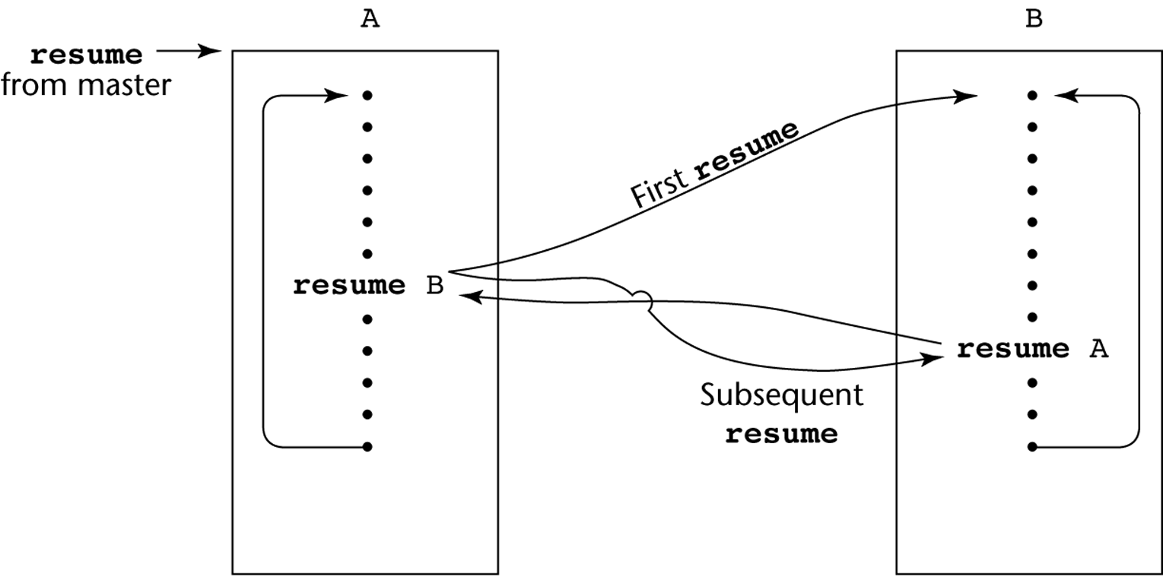
Coroutines Illustrated:
Possible Execution Controls with Loops
20
Notes:
Separate the loop's control flow from the coroutine's saved position. The master starts A. When A first transfers to B, B begins at its initial entry point. B runs to resume A and suspends. A then continues after its resume B, finishes the rest of its loop body, and follows its internal loop arrow back to the top. When A reaches resume B again, B continues after its previous resume A rather than restarting at the top. B reaches the end of its own loop and only then follows its loop arrow back to the beginning of that loop. Thus a loop can revisit statements while the coroutine still preserves the correct continuation between transfers. Ask: 'Does every resume of B go to B's first dot?' The answer is no. Only B's first execution does; later transfers use its saved position. This is the distinction made by the image's First resume and Subsequent resume arrows.
References
https://docs.julialang.org/en/v1/manual/asynchronous-programming/
https://www.lua.org/pil/9.1.html

Slide 21
Coroutines: Language Support
C++ (since C++20)
C#
D
F#
Go (goroutines)
JavaScript
Julia
Lua
PHP
Prolog (delayed goals)
Python
Ruby
Rust (async/await)
Scheme (continuations)
Suspension mechanisms and scheduling differ by language.
21
Notes:
The common theme is suspension or deferred progress, but the APIs and execution models differ. C++20 provides language-level coroutine machinery. C# combines async methods with iterator methods, and F# offers asynchronous computations. JavaScript and Python provide generators as well as async functions. D and Ruby provide fibers; PHP supports generators and, from PHP 8.1, fibers with their own suspendable call stack. Lua has explicit resume/yield operations. Julia's Task abstraction supports symmetric transfers at its low level, although applications commonly use its scheduler and channels. Go's goroutines are independently scheduled functions managed by the runtime. They can be preempted and can execute in parallel, so the previous one-thread diagram is not a universal scheduling model. In SWI-Prolog, coroutining delays a goal until information such as a variable binding becomes available. Scheme's continuations are a more general control mechanism from which coroutine facilities can be built. Rust has stable async/await and futures; its general Coroutine API is still marked experimental in the current documentation. Treat the list as examples of related facilities, not a claim that every language implements the same resume operation.
References
https://timsong-cpp.github.io/cppwp/n4861/dcl.fct.def.coroutine
https://learn.microsoft.com/en-us/dotnet/csharp/language-reference/keywords/async
https://github.com/dotnet/docs/blob/main/docs/csharp/language-reference/statements/yield.md
https://dlang.org/library/core/thread/fiber/fiber.html
https://learn.microsoft.com/en-us/dotnet/fsharp/language-reference/async-expressions
https://go.dev/doc/faq#goroutines
https://tc39.es/ecma262/2025/multipage/control-abstraction-objects.html
https://docs.julialang.org/en/v1/manual/asynchronous-programming/
https://www.lua.org/manual/5.4/manual.html#2.6
https://www.php.net/manual/en/language.fibers.php
https://www.swi-prolog.org/pldoc/man?section=coroutining
https://peps.python.org/pep-0342/
https://docs.ruby-lang.org/en/master/Fiber.html
https://doc.rust-lang.org/book/ch17-01-futures-and-syntax.html
https://doc.rust-lang.org/std/ops/trait.Coroutine.html
https://www.gnu.org/software/guile/manual/html_node/Continuations.html

Slide 22
Coroutines Example
Python
def match(pattern):
print('Looking for ' + pattern)
try:
while True:
s = (yield)
if pattern in s:
print(s)
except GeneratorExit:
print('Done.')
22
Notes:
This generator is used as a coroutine that receives data. Calling match('hello') creates a generator object; it does not yet print the opening message or run the body. The first next call starts execution, prints Looking for hello, and pauses at the bare yield. Because yield has no outgoing value, that next call returns None. At this moment the assignment to s has not completed. A later send(text) makes the suspended yield expression evaluate to text, so the assignment stores that string in s. The condition performs a case-sensitive substring test. Matching strings are printed, and the loop then returns to yield to wait for another input. The same pattern argument and local execution state survive every pause. close() injects GeneratorExit at the suspension point. The handler prints Done., then the function finishes. It is correct for this handler to end rather than yield another value. Emphasize the input contract: after priming, use send with strings. Calling next again instead would supply None, which does not support this string-membership test.
References
https://docs.python.org/3.13/reference/expressions.html#generator-iterator-methods
https://peps.python.org/pep-0342/

Slide 23
Coroutines Example
>>> matcher = match('hello')
>>> next(matcher)
Looking for hello
>>> matcher.send('hello there')
hello there
>>> matcher.send('goodbye now')
>>> matcher.send('Othello is a great play')
Othello is a great play
>>> matcher.close()
Done.
yield pauses execution.
send(value) resumes execution and supplies the value
assigned to s.
23
Notes:
Walk through each interaction and ask what is printed. First, matcher = match('hello') creates an object and prints nothing. next(matcher) primes it, producing Looking for hello and leaving it suspended at yield. Sending hello there assigns that string to s, satisfies the substring condition, and prints it. Sending goodbye now produces no output because the condition is false, but the generator still returns to the same waiting point. Othello is a great play does match: Othello contains the exact lowercase letters hello beginning at character index 2. The operation tests a substring, not a whole word. close() resumes the suspended point with GeneratorExit, so the handler prints Done. and the object becomes closed. Each successful send here returns None; the visible lines are printed side effects. Before priming, sending a non-None value raises TypeError because no yield expression is waiting to receive it. After close, next raises StopIteration. A useful extension is to ask how whole-word matching would change the Othello result. Whole-word matching would require a different condition.
FUNCTION REFERENCE
def match(pattern):
print('Looking for ' + pattern)
try:
while True:
s = (yield)
if pattern in s:
print(s)
except GeneratorExit:
print('Done.')
References
https://docs.python.org/3.13/reference/expressions.html#generator-iterator-methods
https://peps.python.org/pep-0342/

Slide 24
Generators
Generators are a restricted form of coroutine.
Each request can produce the next value in a sequence.
Calling a generator function creates a generator. Its body runs when values are requested.
24
Notes:
A generator is useful when the caller needs a sequence a little at a time. The caller controls the pace by requesting another value. The generator retains its local state between requests, so it can continue the same calculation rather than start again. In Python, an ordinary def that contains yield defines a generator function. Calling that function produces a generator object. The function body has not run yet. Argument expressions are still evaluated normally at the call site, so the statement about deferred execution concerns the generator body.
For the examples that follow, distinguish the function from its result. natural is the function, while gen = natural() stores one particular generator. next(gen) advances that object. Calling natural() again creates a separate sequence starting at zero. A generator need not produce a different value on every request: ones() deliberately yields 1 repeatedly. It can also finish after a finite sequence.
The coroutine connection is suspension and resumption. This generator yields control back to its caller. Python's ordinary generator object is also distinct from a native async def coroutine object, even though both support suspended execution.
References
https://docs.python.org/3/reference/expressions.html#yield-expressions
https://peps.python.org/pep-0380/

Slide 25
Generators
Goal
Pause the subprogram while preserving its local state.
Use yield to suspend execution and produce a value.
Use return, or reach the end, to finish the generator.
25
Notes:
The design goal is to give the caller a result now while keeping enough state to continue later. A normal return finishes a particular function activation. A yield makes a generator available for another request. The generator keeps its local variables and its position in the code, so the programmer does not need to move all of that state into a separate iterator class.
A generator is allowed to contain return. In a Python generator, reaching return or falling off the end means that there are no more yielded values. The next request then raises StopIteration, which a for loop handles automatically. A return expression can supply a final completion value, but that value does not become an additional item in ordinary iteration.
For example, a function containing yield 5 followed by return 42 produces one item: 5. On the next request, StopIteration.value is 42. list(the_generator) therefore collects [5], not [5, 42]. This is useful when later explaining yield from, because a delegating generator can receive that completion value. Ask students which operation makes the current invocation resumable: yield is the suspension point.
References
https://docs.python.org/3/reference/simple_stmts.html#the-return-statement
https://peps.python.org/pep-0380/

Slide 26
Generators
yield produces a value and pauses execution.
The generator retains its local state.
next(gen) resumes it after its last yield.
Python
def first_three():
yield 1
yield 2
yield 3
26
Notes:
Work through the example by keeping the same generator object:
gen = first_three()
next(gen) # 1
next(gen) # 2
next(gen) # 3
next(gen) # raises StopIteration
The assignment creates the generator. The first next call starts the body and stops at yield 1. The second next call continues after that yield and stops at yield 2. The third behaves the same way at yield 3. At this moment the generator is still suspended at its third yield. A fourth request resumes it, reaches the end of the function, and signals completion.
A for loop repeatedly performs these requests and stops normally when the generator is exhausted. Thus list(first_three()) evaluates to [1, 2, 3]. Once a generator has finished, advancing that same object does not restart it. To repeat the sequence, call first_three() to create another generator.
A useful check is next(first_three()). It returns 1 every time that whole expression is evaluated because each evaluation creates a new generator. This makes the difference between constructing a generator and resuming an existing one concrete.
References
https://docs.python.org/3/tutorial/classes.html#generators

Slide 27
Generators
def ones():
while True:
yield 1
gen = natural()
next(gen) # 0
next(gen) # 1
next(gen) # 2
next(gen) # 3
def natural():
x = 0
while True:
yield x
x += 1
next(gen) and gen.send(value) resume the generator.
27
Notes:
The two functions show why a generator is not required to change its output. ones() is an infinite sequence of 1s. natural() begins at zero and remembers x between requests. For natural(), the first request initializes x to 0 and suspends at yield x. The second request first executes x += 1, then starts the next loop iteration and yields 1. The next two requests yield 2 and 3. The increment occurs when execution resumes, not while the generator is paused.
Both next(gen) and gen.send(value) can resume this object. next(gen) is equivalent to gen.send(None). A non-None sent value becomes the result of the suspended yield expression. This particular natural() function does not assign that expression to anything, so it ignores any sent value. After the four next calls shown, gen.send(99) yields 4, not 99. In the earlier matcher example, s = (yield) does capture the sent value.
A new generator must first be started with next(gen) or gen.send(None). Sending a non-None value before its first yield raises TypeError. To inspect an infinite sequence safely, use a finite request such as list(islice(ones(), 4)), which produces [1, 1, 1, 1], after importing islice from itertools.
References
https://peps.python.org/pep-0342/
https://docs.python.org/3/library/itertools.html#itertools.islice

Slide 28
Generators
Fibonacci exercise
Complete the loop to yield 0, 1, 1, 2, 3, 5, …
def fibonacci():
a, b = 0, 1
while True:
... # complete the loop body
Keep a pair of consecutive values. Yield first, then update the pair.
28
Notes:
The loop needs two operations: yield the current Fibonacci number, then advance the pair of consecutive numbers. The complete solution is:
def fibonacci():
a, b = 0, 1
while True:
yield a
a, b = b, a + b
Keep the invariant that a is the next number to yield and b is the following one. Initially the pair is (0, 1), so the first next call produces 0. On the second request, the suspended yield finishes, the simultaneous assignment changes the pair to (1, 1), and the loop yields 1. The next pairs are (1, 2), (2, 3), (3, 5), and (5, 8). The emitted values are therefore 0, 1, 1, 2, 3, 5.
The right-hand side of a, b = b, a + b uses the old values of both variables before either target is assigned. Replacing it with a = b followed by b = a + b incorrectly uses the updated a in the sum. Starting from (0, 1), that mistake produces (1, 2) instead of (1, 1).
To request a finite sample:
from itertools import islice
list(islice(fibonacci(), 10))
# [0, 1, 1, 2, 3, 5, 8, 13, 21, 34]
The displayed exercise is a skeleton; fill in the two loop statements before running it. The completed function has an intentionally infinite loop, so avoid list(fibonacci()). It holds only the current pair of integers instead of retaining all earlier results, although the integers themselves grow as the sequence advances.
References
https://peps.python.org/pep-0255/
https://docs.python.org/3/library/itertools.html#itertools.islice
https://docs.python.org/3/reference/simple_stmts.html#the-return-statement

Slide 29
Recursive Generators
from os import listdir
from os.path import isdir, isfile, islink, join
def print_files(dir):
for file in listdir(dir):
full_path = join(dir, file)
if isfile(full_path):
yield full_path
elif (isdir(full_path)
and not islink(full_path)):
yield from print_files(full_path)
yield from forwards each path produced by the
recursive generator.
29
Notes:
Despite its name, print_files yields file paths. It does not print them. A caller chooses what to do with each path:
for path in print_files("demo"):
print(path)
For a walkthrough, suppose demo contains a.txt and a subdirectory sub, with b.txt inside sub. Suppose listdir visits a.txt first. The outer generator yields demo/a.txt and pauses. On the next request it reaches sub and constructs a child generator. yield from forwards the child's yielded demo/sub/b.txt to the original caller. When that child finishes, the outer loop continues. Each recursive activation has its own dir, file, and full_path. Calling print_files(full_path) alone would only create a generator object; yield from is what iterates it and forwards its values. In this simple traversal, it behaves like a for loop that re-yields each child result.
The explicit isdir test prevents treating a broken link, pipe, or other nonfile entry as a directory. The islink guard prevents descent through directory symlinks, which can lead back to an ancestor. A symlink to a regular file still passes isfile and is yielded. The function visits depth first, but listdir does not promise alphabetical order. Use sorted(listdir(dir)) if a deterministic teaching trace is needed.
This is a compact traversal example. It assumes an accessible directory tree without concurrent changes. Filesystem errors can propagate, and very deep recursion can exceed Python's recursion limit. The directory-symlink guard is not a universal cycle detector for every filesystem alias, such as Windows junctions or unusual mount structures.
References
https://peps.python.org/pep-0380/
https://docs.python.org/3/library/os.path.html
https://docs.python.org/3/library/os.html#os.listdir

